Slide 1
October 22 Update
Appendix C

Slide 2
Fourier representation of parametrized circuits

Slide 3
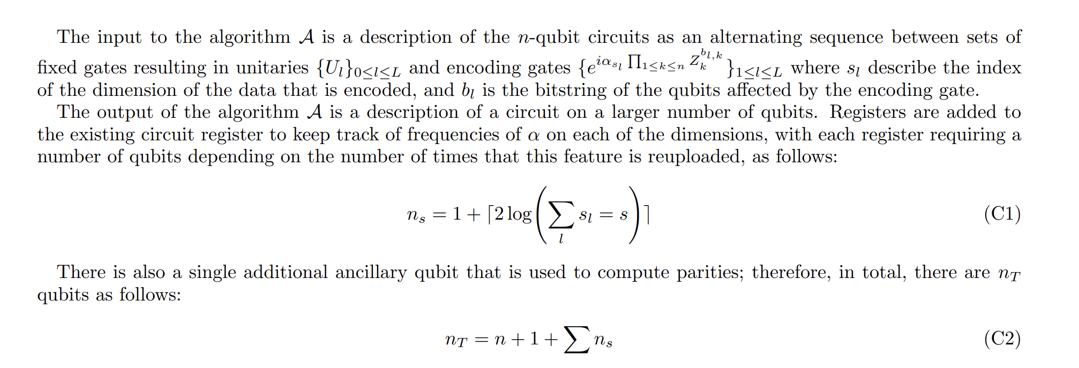
Description of the algorithm
Minor Issue: Fixed gate and encoding gate limits on l are not the same

Slide 4
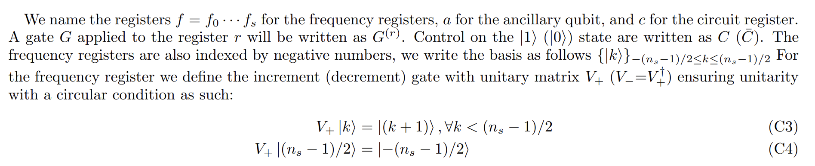

Slide 5
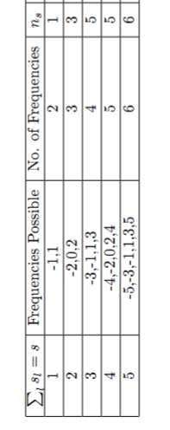
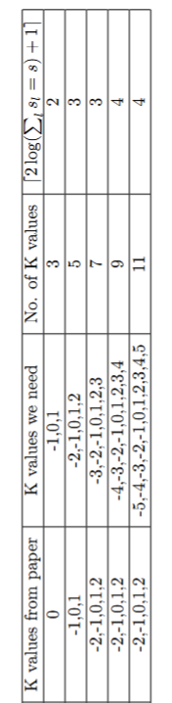
Issues with n_{s}

Slide 6
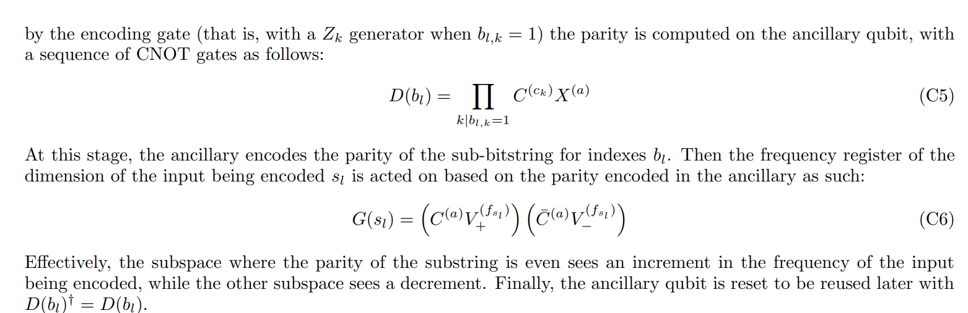

Slide 7
Issues with previous part
k is being used a lot to represent different things
G seems incorrect, will explain more in proof section

Slide 8
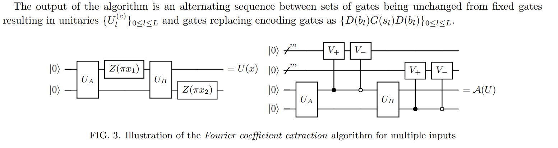
Minor issue: Doesn’t show ancilla

Slide 9
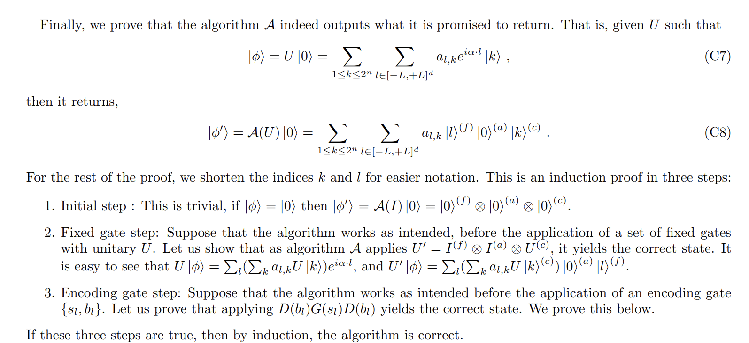
Proof

Slide 10
Issues with previous part
Should {s_{l}, b_{l}} be the gate being added since l is in summation already?
Should use {s_{l’}, b_{l’}} ?
Maybe shouldn’t use U again but something else

Slide 11
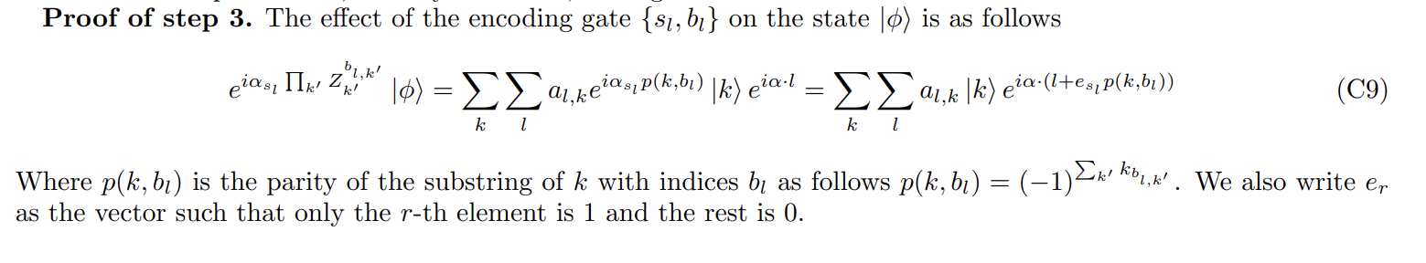

Slide 12
Issues with previous part
Here, parity notation is confusing
Why does adding an encoding gate not affect the coefficient?

Slide 13
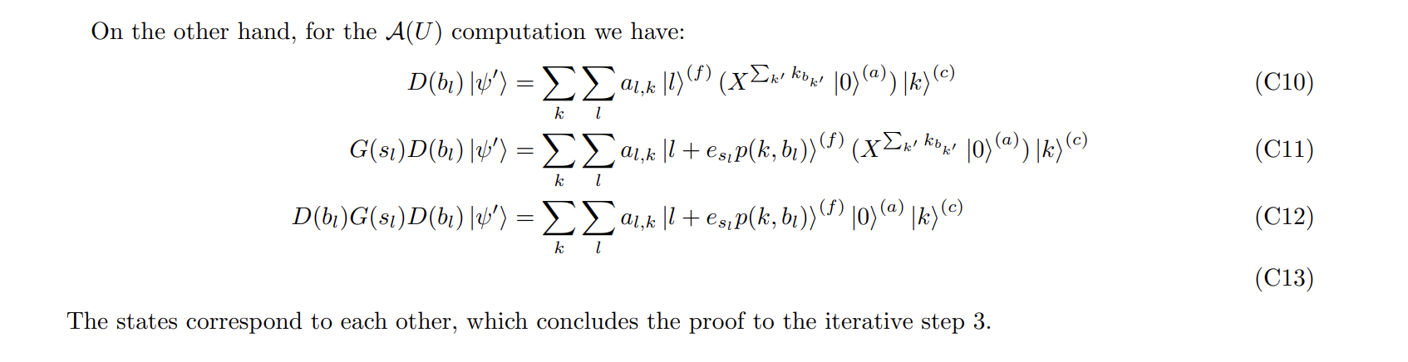

Slide 14
Issues with previous part
In C9, -1 for odd, 1 for even, opposite here
Need to change G
Here also coefficient is not affected

Slide 15
Frequency representation of expectation values

Slide 16
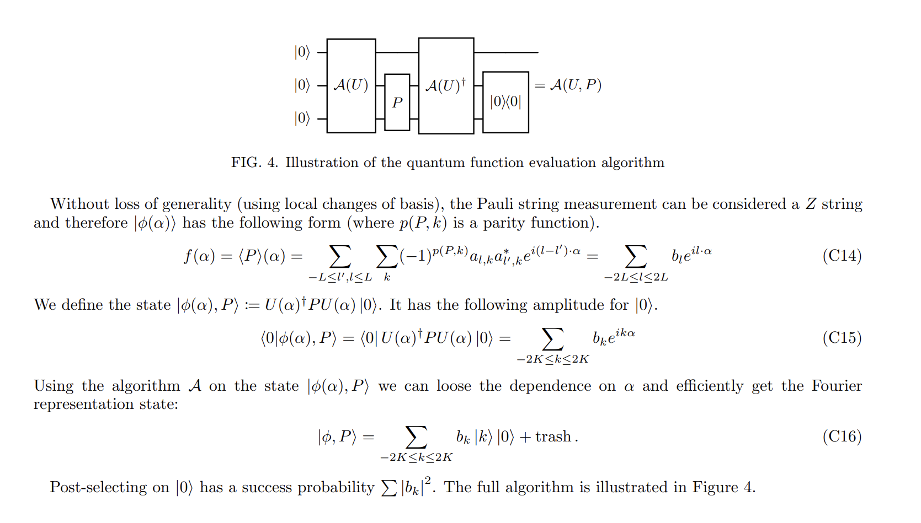
Pauli observable

Slide 17
Issues with previous part
C14 has (-1)^P(P,k). This doesn’t match what we have seen till now
Also C14 has -L <= l <= L but shouldn’t it be dimension d?(Same issue in C15, C16, C21 and maybe some other places

Slide 18
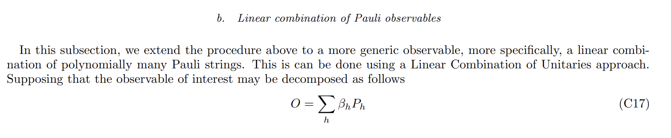
Linear combination of Pauli observables

Slide 19
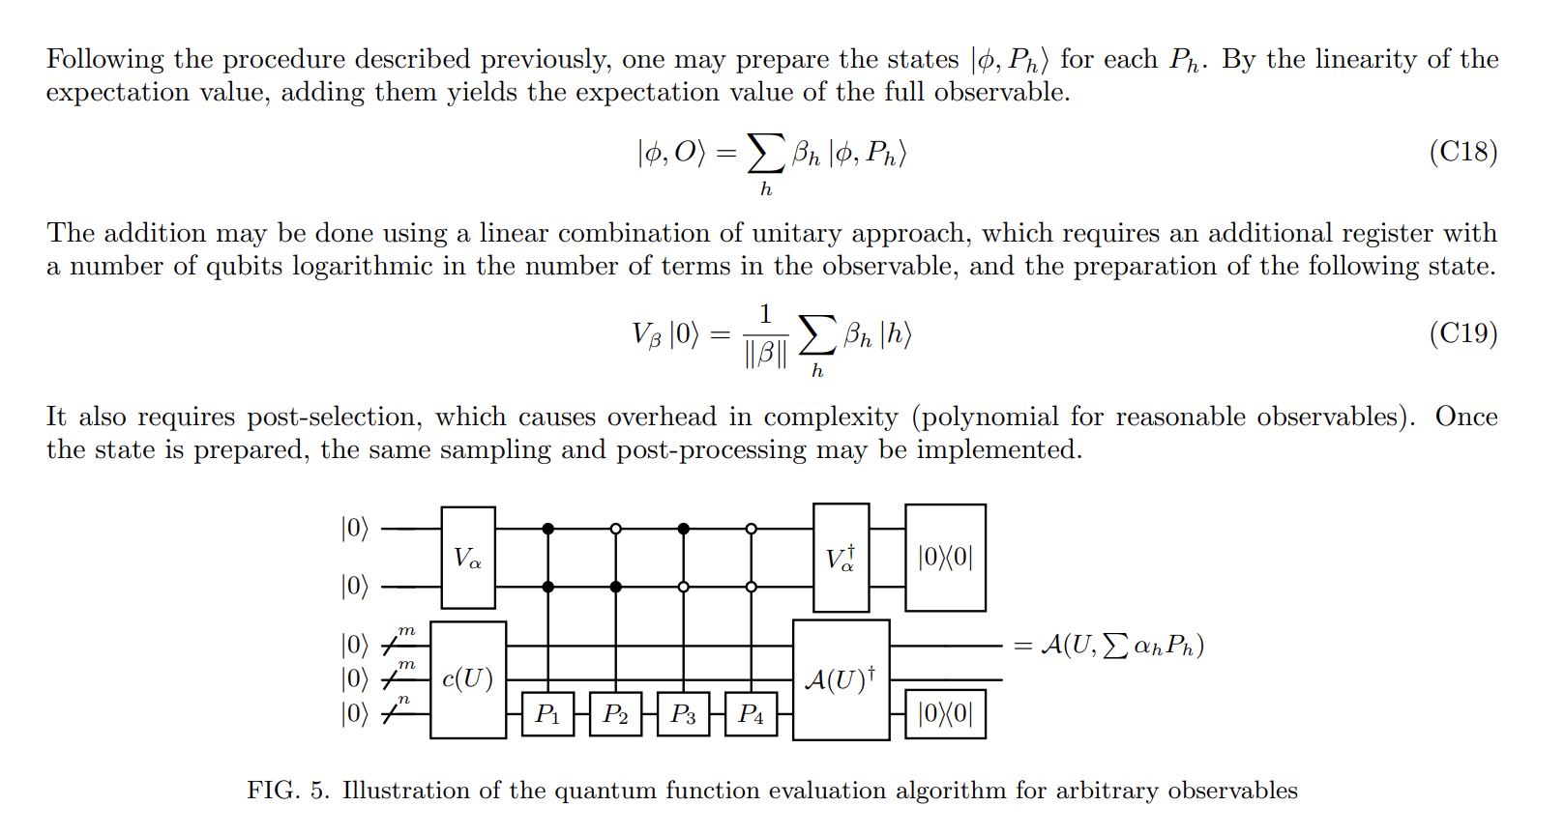

Slide 20
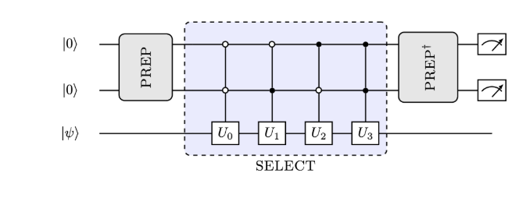
Issues with previous part
Should be A(U) instead of c(U) in fig 5 first part, also used alpha instead of beta
In fig 5, how do we get number of qubits for each register?
Shouldn’t P gates be 0,1,2,3 with appropriate control(correct notation)?
Pennylane

Slide 21
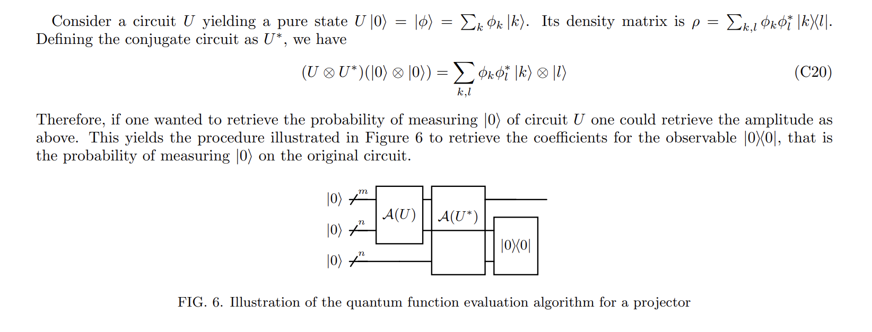
Probabilities, or projectors observables

Slide 22
Issues with previous part
Not really sure why we do this?
Also number of qubits in each wire

Slide 23
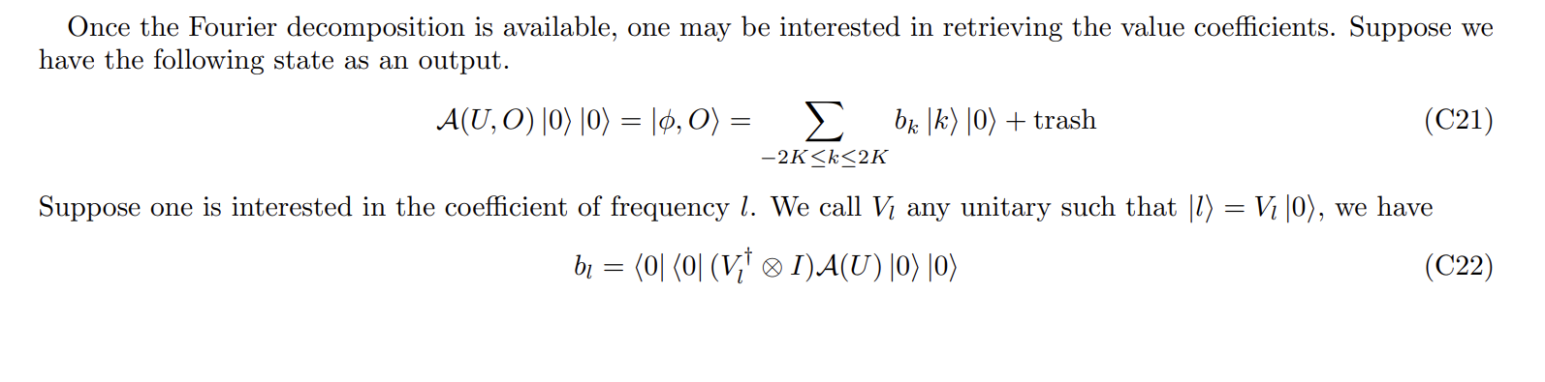
Extracting Fourier coefficients

Slide 24
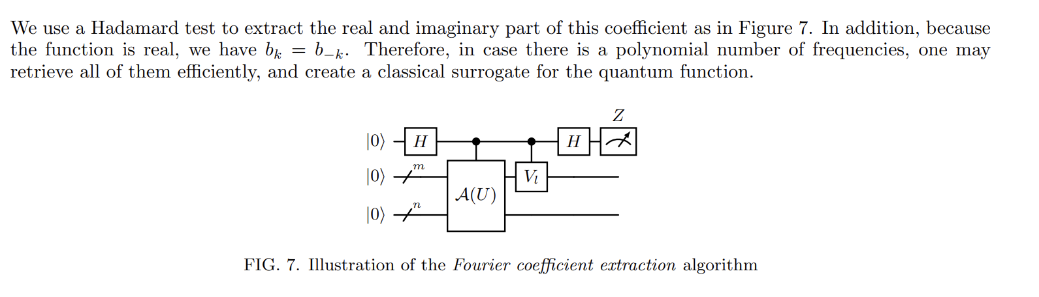

Slide 25
Issues with previous part
How do you find/make V_{l}?
Is the aim to get the b_{k}’s via quantum then construct classically so that we don’t have to keep using the quantum computer?

Slide 26
Things to do

Slide 27
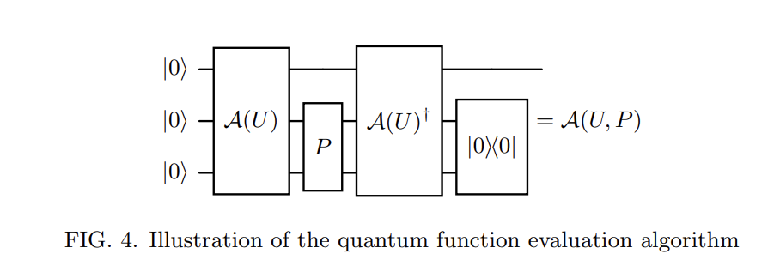
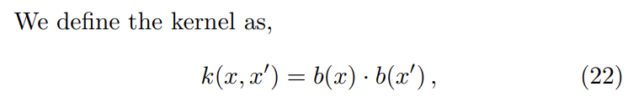
Computing kernel matrix

Slide 28
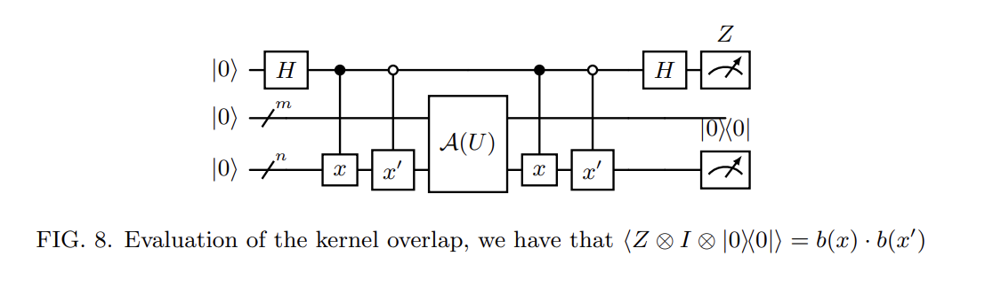
Kernel Method in Appendix

Slide 29
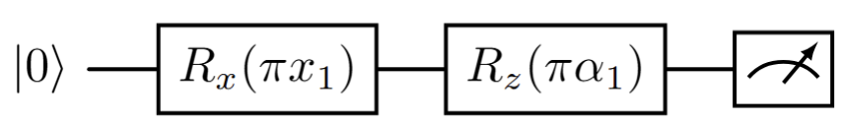
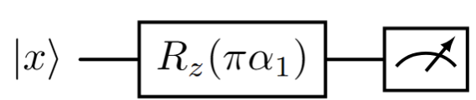
Is this circuit fine?

Slide 30
Things to do
Try computing both methods for very simple/small circuits
Make code to run larger circuits
Email Alice for previous numerics/calculations/code/etc
Start going through the book again
Reorganize notes

